Slide 1

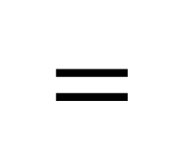
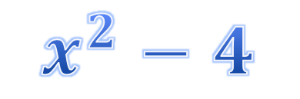

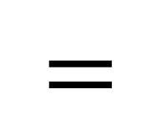
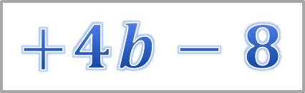
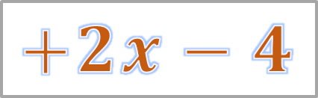

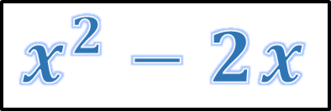
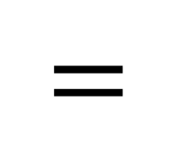
More about Factorization
$$\left(x+2\right)\left(x−2\right)$$
$$=$$
$$x^{2}−2x$$
$$+2x−4$$
$$\left(a+2\right)\left(2b−4\right)$$
$$=$$
$$x^{2}−4$$
$$=$$
$$2ab−4a$$
$$+4b−8$$

Slide 2

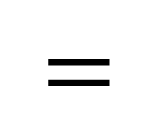
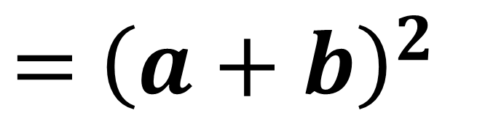

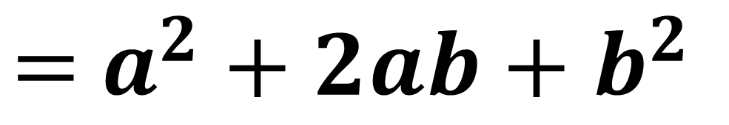



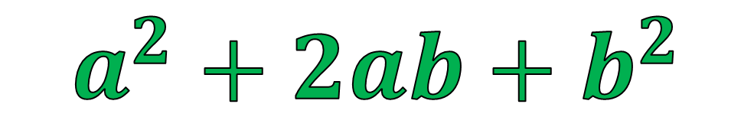
$${\left(a+b\right)}^{2}$$
$=$ ${\left(a+b\right)}^{2}$
$$\left(a+b\right)\left(a+b\right)$$
$$=$$
$$a^{2}+ab$$
$$+ab+b^{2}$$
$=$ $a^{2}+2ab+b^{2}$
$$a^{2}+2ab+b^{2}$$
$$≡$$

Slide 3

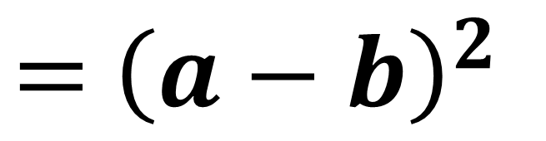

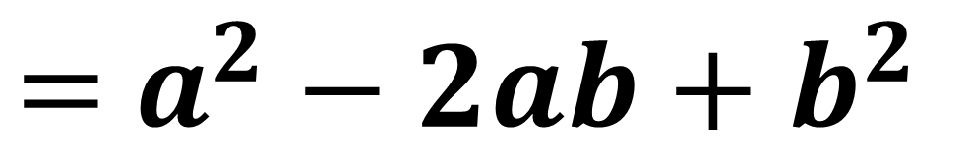
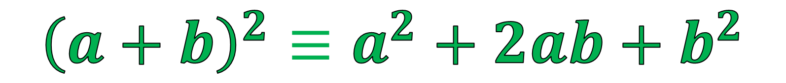


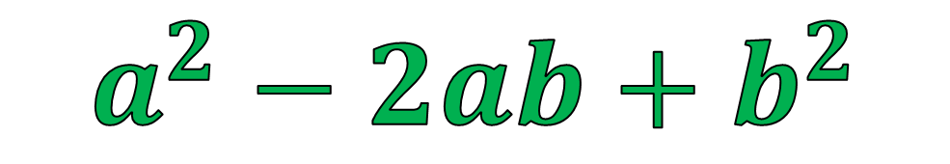
$${\left(a−b\right)}^{2}$$
$=$ ${\left(a−b\right)}^{2}$
$$\left(a−b\right)\left(a−b\right)$$
$$=$$
$$a^{2}−ab$$
$$−ab+b^{2}$$
$=$ $a^{2}−2ab+b^{2}$
$$a^{2}−2ab+b^{2}$$
$$≡$$
$${\left(a+b\right)}^{2}≡a^{2}+2ab+b^{2}$$

Slide 4

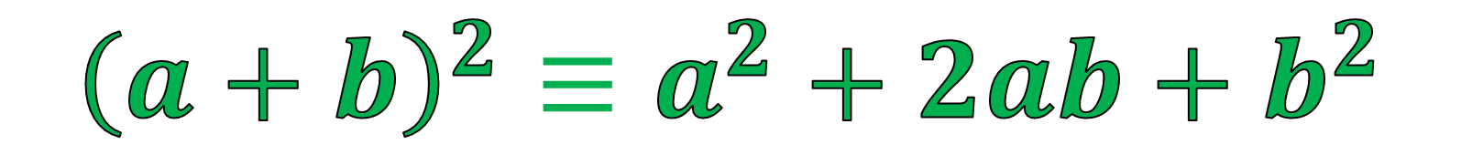
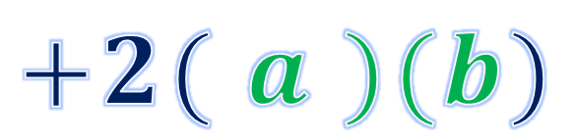
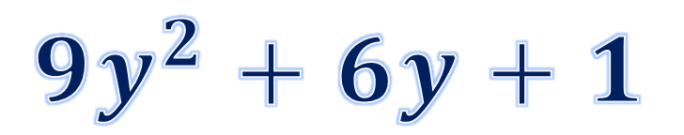
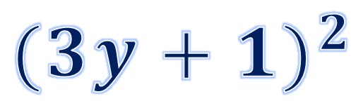



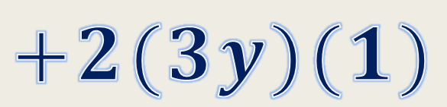
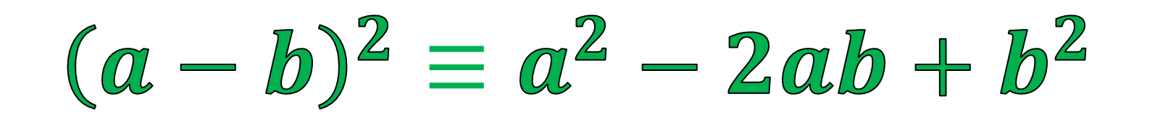

$${(3y+1)}^{2}$$
$${( a )}^{2}$$
$${(3y)}^{2}$$
$$+2(3y)(1)$$
$$=$$
$$+2( a )(b)$$
$$+{\left(b\right)}^{2}$$
$$+{\left(1\right)}^{2}$$
$$=$$
$${9y}^{2}+6y+1$$
$${\left(a+b\right)}^{2}≡a^{2}+2ab+b^{2}$$
$${\left(a−b\right)}^{2}≡a^{2}−2ab+b^{2}$$

Slide 5

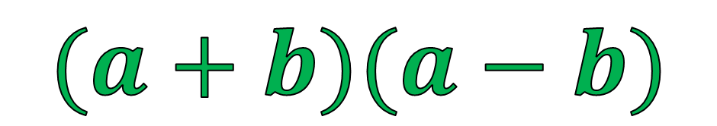
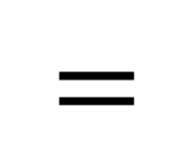
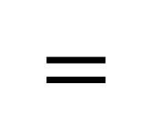




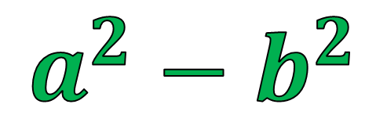
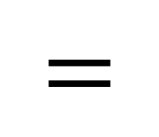

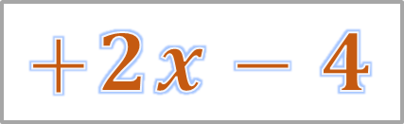





$$(a+b)(a−b)$$
$$\left(x+2\right)\left(x−2\right)$$
$$a$$
$$b$$
$$a$$
$$b$$
$$=$$
$$x^{2}−2x$$
$$+2x−4$$
$$=$$
$$x^{2}−4$$
$$=$$
$$a^{2}−b^{2}$$
$$x^{2}−2^{2}$$
$$a$$
$$b$$
$$≡$$

Slide 6
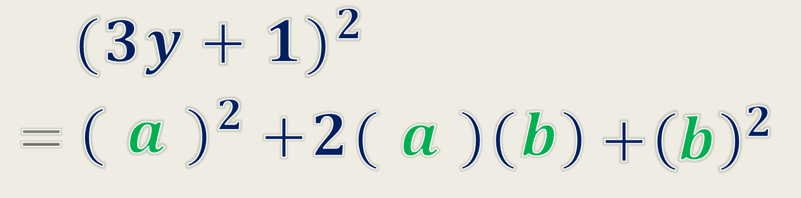
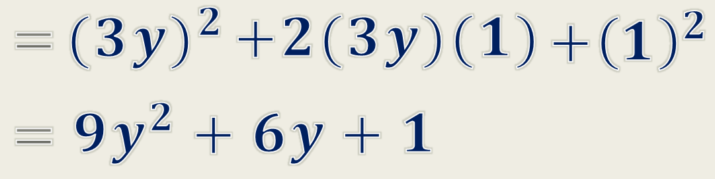

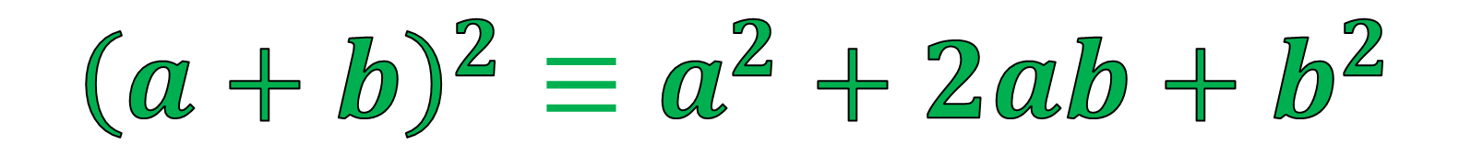
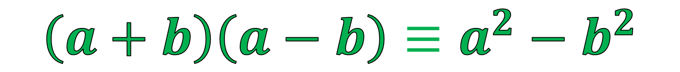
Summary
$${\left(a+b\right)}^{2}≡a^{2}+2ab+b^{2}$$
$${\left(a−b\right)}^{2}≡a^{2}−2ab+b^{2}$$
$$\left(a+b\right)\left(a−b\right)≡a^{2}−b^{2}$$

Slide 7











































Factorize the following expressions.
1. $a^{2}+4a+4$
2. $25d^{2}+20d+4$
3. $16m^{2}+8mn+n^{2}$
$$=$$
(a
$$+$$
2)
2
$$=$$
$$+$$
2
$$=$$
$$+$$
n)
2
(5d
2)
(4m
4. $9b^{2}−6b+1$
5. $4c^{2}−12c+9$
6. $p^{2}−10pq+25q^{2}$
$$=$$
$$−$$
2
2
$$=$$
(p
$$−$$
5q)
2
(3b
1)
$$=$$
$$−$$
(2c
3)
7. $36m^{2}−25n^{2}$
8. $4a^{4}−b^{2}c^{2}$
9. $25a^{2}−16$
$$=$$
$$=$$
2
2
$$=$$
$$−$$
$$−$$
$$+$$
(5a
4)
$$+$$
(2a
bc)
(5a
4)
(6m
$$+$$
5n)
(6m
$$−$$
5n)
(2a
bc)
10. $100h^{2}−169$
11. 36$a^{2}−100$
12. $81h^{2}−144$
$$=$$
$$+$$
$$−$$
$$=$$
$$+$$
$$−$$
$$=$$
$$−$$
(10h
13)
(10h
13)
(6a
10)
(6a
10)
$$+$$
(9h
12)
(9h
12)

Slide 8
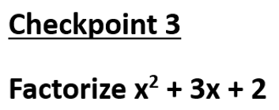
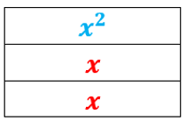
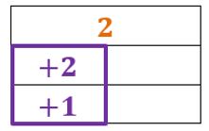
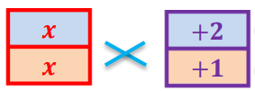













(x
$$+$$
2)
(x
$$+$$
1)
1
2
$$+$$
$$=$$
x
$$+$$
x
3
2
(x
$$+$$
2)
(x
$$+$$
1)
2
Multiply
x
$$+$$
2x
$$=$$
3x
2
x
x
$$+$$
3
2
$$+$$

Slide 9




































Factorize the following expressions.
13. $x^{2}+4x+3$
14. $x^{2}+5x+4$
15. $x^{2}+6x+5$
$$=$$
(x
$$+$$
1)
(x
$$+$$
3)
$$=$$
(x
$$+$$
1)
(x
$$+$$
4)
$$=$$
(x
$$+$$
1)
(x
$$+$$
5)
16. $x^{2}+7x+6$
17. $x^{2}+5x+6$
18. $x^{2}+8x+7$
$$=$$
(x
$$+$$
1)
(x
$$+$$
6)
$$=$$
(x
$$+$$
2)
(x
$$+$$
3)
$$=$$
(x
$$+$$
1)
(x
$$+$$
7)
19. $x^{2}+9x+8$
20. $x^{2}+6x+8$
21. $x^{2}+10x+9$
$$=$$
(x
$$+$$
1)
(x
$$+$$
8)
$$=$$
(x
$$+$$
2)
(x
$$+$$
4)
$$=$$
(x
$$+$$
1)
(x
$$+$$
9)
22. $x^{2}+6x+9$
$$=$$
(x
$$+$$
3)
2

Slide 10
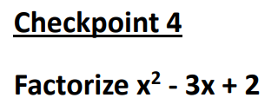
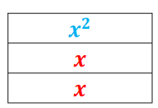
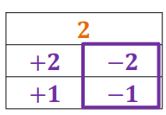
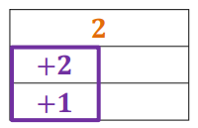
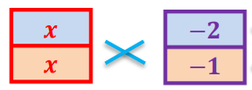












(x
$$−$$
2)
(x
$$−$$
1)
1
2
$$+$$
$$=$$
x
$$−$$
x
3
2
(x
$$−$$
2)
(x
$$−$$
1)
2
Multiply
$$+$$
$$−$$
2x)
$$=$$
$−$3x
$$−$$
x)
(
(
2
$$+$$
x
$$−$$
x
3
2

Slide 11






































Factorize the following expressions.
23. $x^{2}−10x+9$
24. $x^{2}−11x+10$
25. $x^{2}−7x+10$
$$=$$
(x
$$−$$
1)
(x
$$−$$
9)
$$=$$
(x
$$−$$
1)
(x
$$−$$
10)
$$=$$
(x
$$−$$
2)
(x
$$−$$
5)
26. $x^{2}−12x+11$
27. $x^{2}−13x+12$
28. $x^{2}−8x+12$
$$=$$
(x
$$−$$
1)
(x
$$−$$
11)
$$=$$
(x
$$−$$
1)
(x
$$−$$
12)
$$=$$
(x
$$−$$
2)
(x
$$−$$
6)
29. $x^{2}−7x+12$
30. $x^{2}−14x+13$
31. $x^{2}−15x+14$
$$=$$
(x
$$−$$
3)
(x
$$−$$
4)
$$=$$
(x
$$−$$
1)
(x
$$−$$
13)
$$=$$
(x
$$−$$
1)
(x
$$−$$
14)
32. $x^{2}−9x+14$
33. $x^{2}+8x+15$
34. $x^{2}−10x+16$
$$=$$
(x
$$−$$
2)
(x
$$−$$
7)
$$=$$
(x
$$+$$
3)
(x
$$+$$
5)
$$=$$
(x
$$−$$
2)
(x
$$−$$
8)

Slide 12














































Factorize the following expressions.
35. $x^{2}+18x+17$
36. $x^{2}−9x+18$
37. $x^{2}+20x+19$
$$=$$
(x
$$+$$
1)
(x
$$+$$
17)
$$=$$
(x
$$−$$
3)
(x
$$−$$
6)
$$=$$
(x
$$+$$
1)
(x
$$+$$
19)
38. $x^{2}−9x+20$
39. $x^{2}+10x+21$
40. $x^{2}−13x+22$
$$=$$
(x
$$−$$
4)
(x
$$−$$
5)
$$=$$
(x
$$+$$
3)
(x
$$+$$
7)
$$=$$
(x
$$−$$
2)
(x
$$−$$
11)
41. $x^{2}+24x+23$
42. $x^{2}−14x+24$
43. $x^{2}+26x+25$
$$=$$
(x
$$+$$
1)
(x
$$+$$
23)
$$=$$
(x
$$−$$
2)
(x
$$−$$
12)
$$=$$
(x
$$+$$
1)
(x
$$+$$
25)
44. $x^{2}−15x+26$
45. $x^{2}+12x+27$
46. $x^{2}−11x+28$
$$=$$
(x
$$−$$
2)
(x
$$−$$
13)
$$=$$
(x
$$+$$
3)
(x
$$+$$
9)
$$=$$
(x
$$−$$
4)
(x
$$−$$
7)

Slide 13
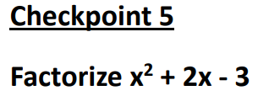
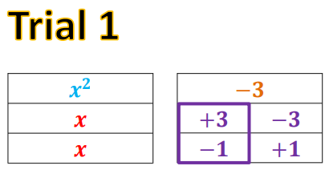


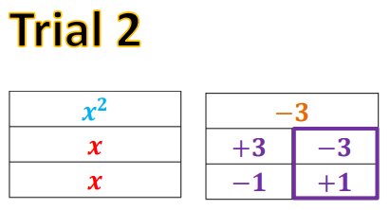


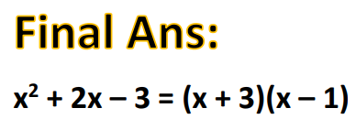













1
2
Multiply
$$−$$
x)
$$+$$
$$=$$
2x
(
3x
2
$$+$$
x
$$+$$
x
2
2
1
2
Multiply
$$−$$
x)
$$+$$
$$−$$
3x)
$$=$$
$−$4x
(
(
2
$$+$$
x
$$−$$
x
4
2

Slide 14
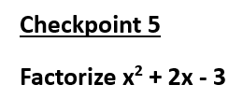
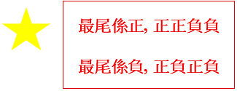

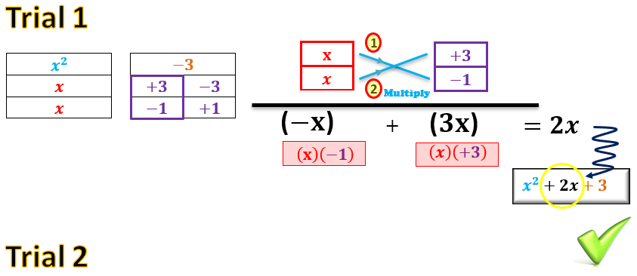



Slide 15














































Factorize the following expressions.
47. $x^{2}−x−2$
48. $x^{2}+x−2$
49. $x^{2}+2x−3$
$$=$$
(x
$$+$$
1)
(x
$$−$$
2)
$$=$$
(x
$$+$$
2)
(x
$$−$$
1)
$$=$$
(x
$$+$$
3)
(x
$$−$$
1)
50. $x^{2}−2x−3$
51. $x^{2}+3x−4$
52. $x^{2}−3x−4$
$$=$$
(x
$$+$$
1)
(x
$$−$$
3)
$$=$$
(x
$$+$$
4)
(x
$$−$$
1)
$$=$$
(x
$$+$$
1)
(x
$$−$$
4)
53. $x^{2}−x−6$
54. $x^{2}+6x−7$
55. $x^{2}−2x−8$
$$=$$
(x
$$+$$
2)
(x
$$−$$
3)
$$=$$
(x
$$+$$
7)
(x
$$−$$
1)
$$=$$
(x
$$+$$
2)
(x
$$−$$
4)
56. $x^{2}+8x−9$
57. $x^{2}−3x−10$
58. $x^{2}+4x−12$
$$=$$
(x
$$−$$
1)
(x
$$+$$
9)
$$=$$
(x
$$+$$
2)
(x
$$−$$
5)
$$=$$
(x
$$+$$
6)
(x
$$−$$
2)

Slide 16























































Factorize the following expressions.
59. $x^{2}+6x+8$
60. $x^{2}−8x+12$
61. $x^{2}−8x−20$
62. $x^{2}+10x+21$
$$=$$
(x
$$+$$
2)
(x
$$+$$
4)
$$=$$
(x
$$−$$
2)
(x
$$−$$
6)
$$=$$
(x
$$+$$
2)
(x
$$−$$
10)
$$=$$
(x
$$+$$
3)
(x
$$+$$
7)
63. $x^{2}−10x+24$
64. $x^{2}−x−30$
65. $x^{2}+12x+32$
66. $x^{2}−13x+36$
$$=$$
(x
$$−$$
4)
(x
$$−$$
6)
$$=$$
(x
$$+$$
5)
(x
$$−$$
6)
$$=$$
(x
$$+$$
8)
(x
$$+$$
4)
$$=$$
(x
$$−$$
4)
(x
$$−$$
9)
67. $x^{2}−6x−40$
68. $x^{2}+13x+42$
69. $x^{2}−18x+45$
70. $x^{2}+2x−48$
$$=$$
(x
$$+$$
4)
(x
$$−$$
10)
$$=$$
(x
$$+$$
6)
(x
$$+$$
7)
$$=$$
(x
$$−$$
3)
(x
$$−$$
15)
$$=$$
(x
$$+$$
8)
(x
$$−$$
6)
71. $x^{2}+17x+52$
72. $x^{2}−17x−200$
$$=$$
(x
$$+$$
4)
(x
$$+$$
13)
$$=$$
(x
$$+$$
8)
(x
$$−$$
25)

